Slide 1
Machine Learning Overview
CS Clinic Auburn-USDA 2025

Slide 2
Task Description
Given a file containing time-series EPG data, predict a waveform type for each timestep of the series.
Input: ~70 EPG recordings, some with multiple probes
EPG Signal [volts] vs Time
Measurement settings [current type, resistance, voltage]
Output
Waveform Type vs Time (ex: NP, NP, NP, …, J, J, … K, …, L, …, Z, … NP)

Slide 3
Approaches
We are viewing this as a sequence-to-sequence prediction task.
To make the task easier, we have a variety of techniques we can utilize, including
Preprocessing
Windowing
Feature extraction
Data augmentation
Finally, we can use post-processing to make the output sequences easier for a human to edit.
[7.4, 8.9, 9.0, 9.1, … ] → [NP, NP, J, J, … ]

Slide 4
Models

Slide 5
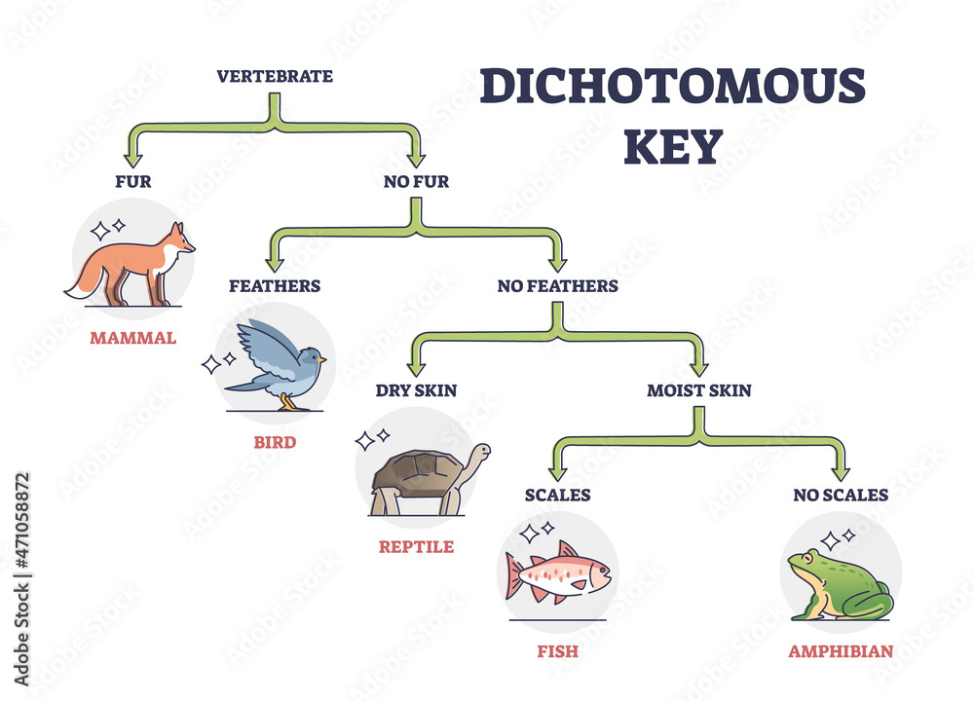
Random Forests
This method largely replicates that of Willett et al.
Decision Tree: like a dichotomous key, but automatically generated for a dataset to maximize the likelihood it makes a correct classification.
Random Forests Model: a large collection of decision trees all trained slightly differently from each other (this gives them some diversity in the way they “think”). We poll all of them and we go with the majority to make our decision.

Slide 6
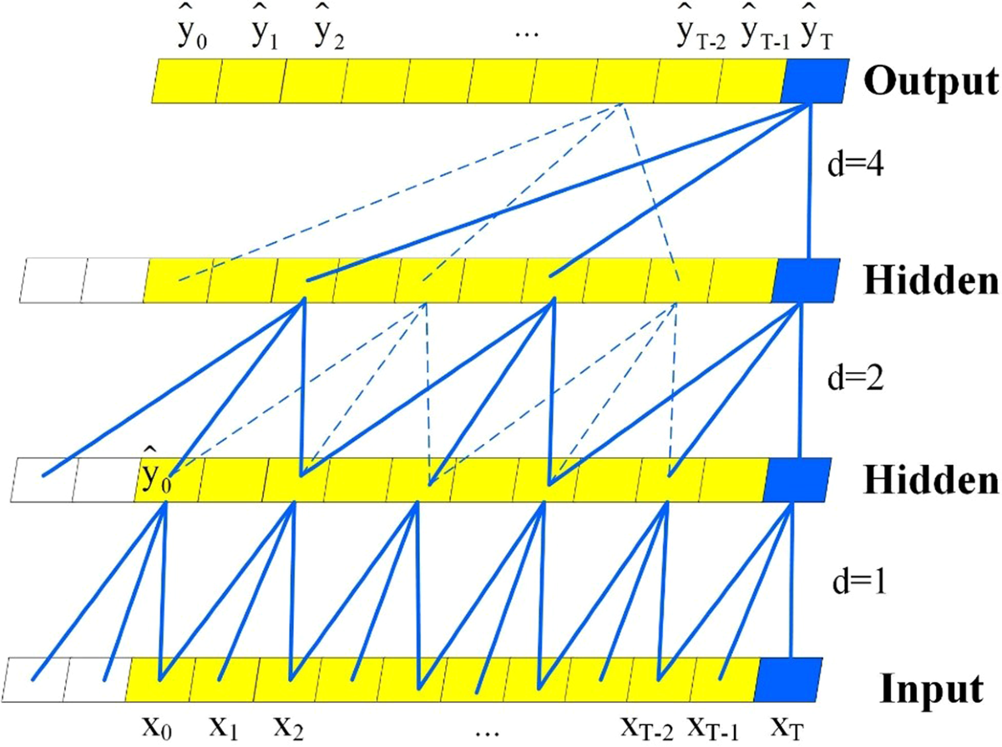
Temporal Convolutional Network (TCN)
While there are many flavors of TCN, our TCN learns to extracts features from the input data in short segments and then feeds them into a neural network. It only processes data at a granular level.

Slide 7
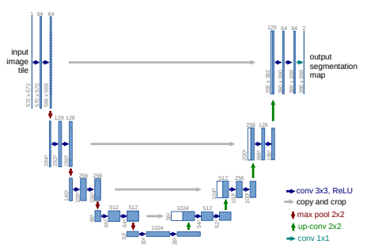
UNet
From Ronneberger, et. al 2015
Originally used for labeling medical images, UNet is a neural network that applies learned filters to the data. Along the way, the data gets compressed and then uncompressed.
This allows the data to be processed at both a high and low level before it is labelled.

Slide 8
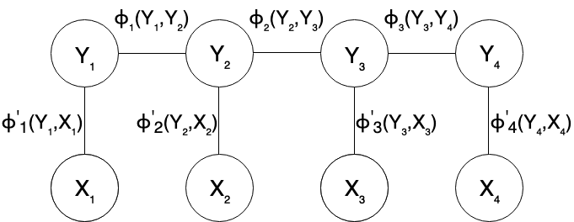
Conditional Random Fields (CRF)
Typically used for labeling text data and images, CRFs allow us to take outputs from any of the previous models and make sure they are coherent given the transitions.

Slide 9
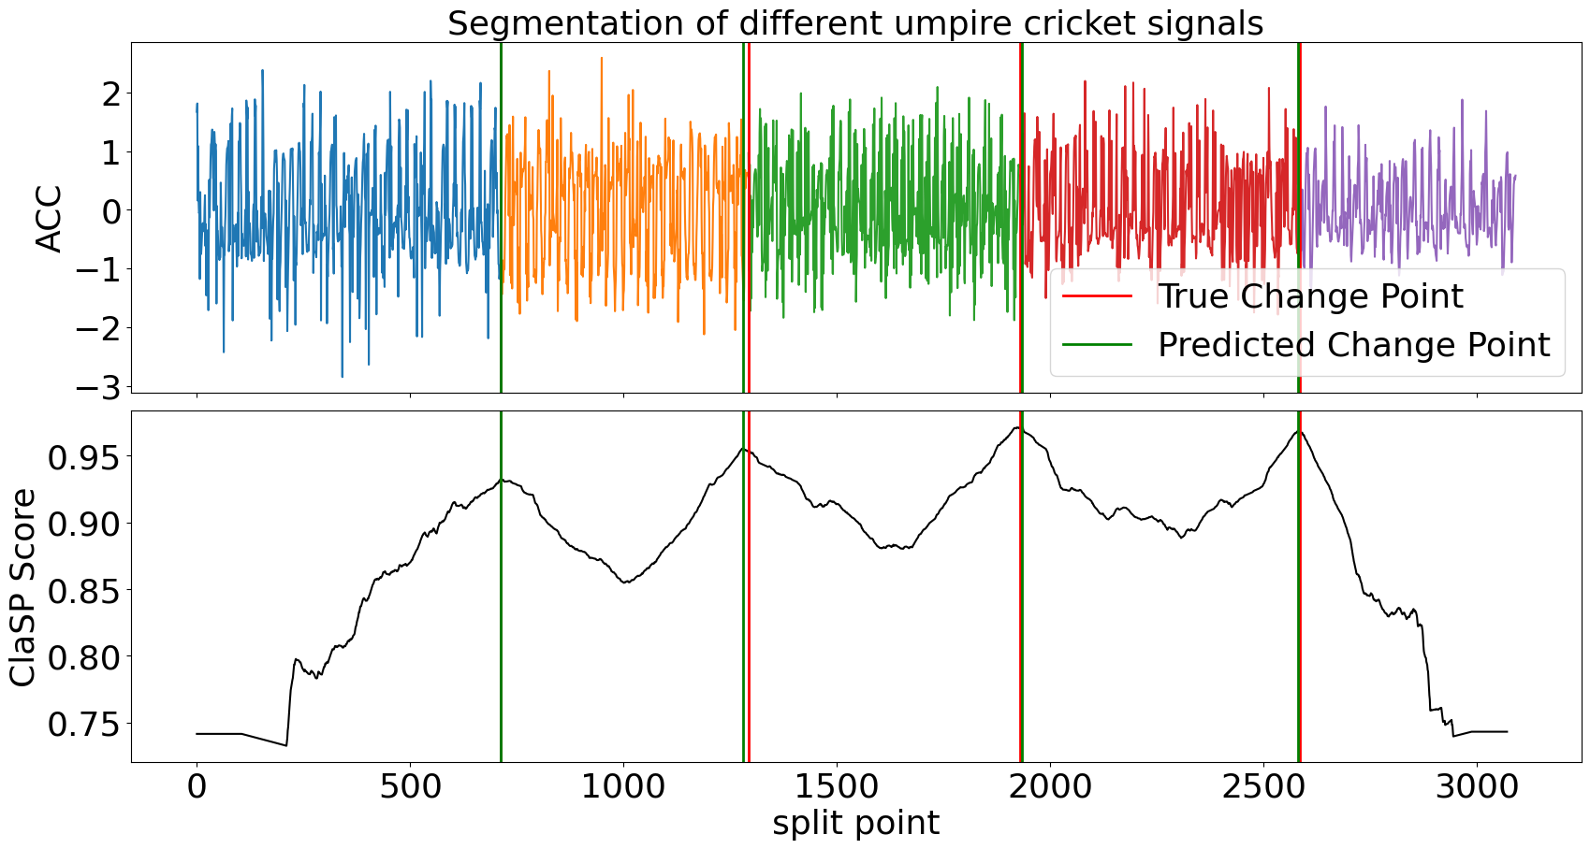
ClaSP + HMMs
Instead of labeling each timestep individually (or in windows), we could first determine which intervals all contain the same waveform type and then label those intervals.
Based on what we have gathered, this is more akin to how humans label data. However, for these methods to work well we need to know how many segments there should be, which is often not possible.

Slide 10
Pre- and post-processing

Slide 11
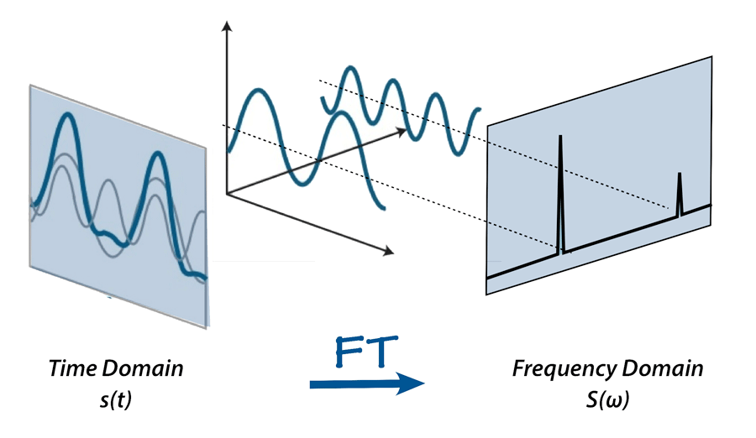
Feature Engineering
Fourier Transform
Extract the frequencies that make up the EPG signal
ClaSP
The filters in the CNNs can be thought of as learning to extract meaningful features from the EPG signal
Fractal Dimension, Hurst Exponent, Etc…
These all measure the “complexity” of data. Other papers have used them but we have not found them to improve performance

Slide 12
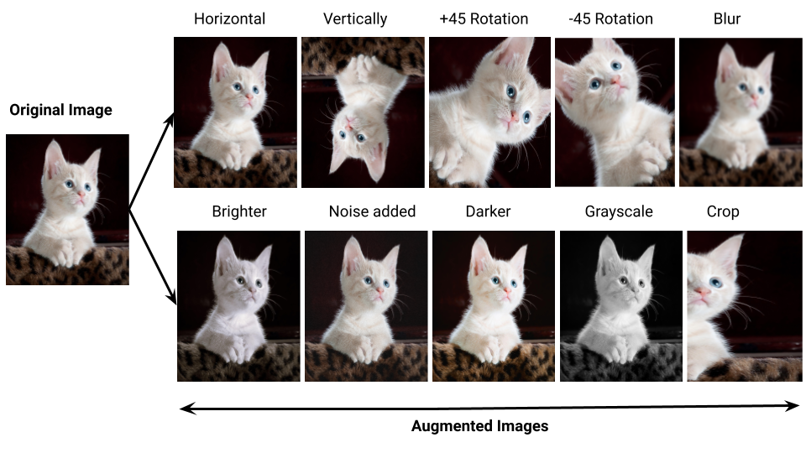
Data Augmentation
Augment_concat_self
Augment_concat_other
Augment_warp_overall
Augment_warp_by_state
Augment_change_amplitude_overall
Augment_change_amplitude_by_state
Augment_noise_voltage_overall
Augment_noise_voltage_by_state
Augment_franken
Combine these together!

Slide 13
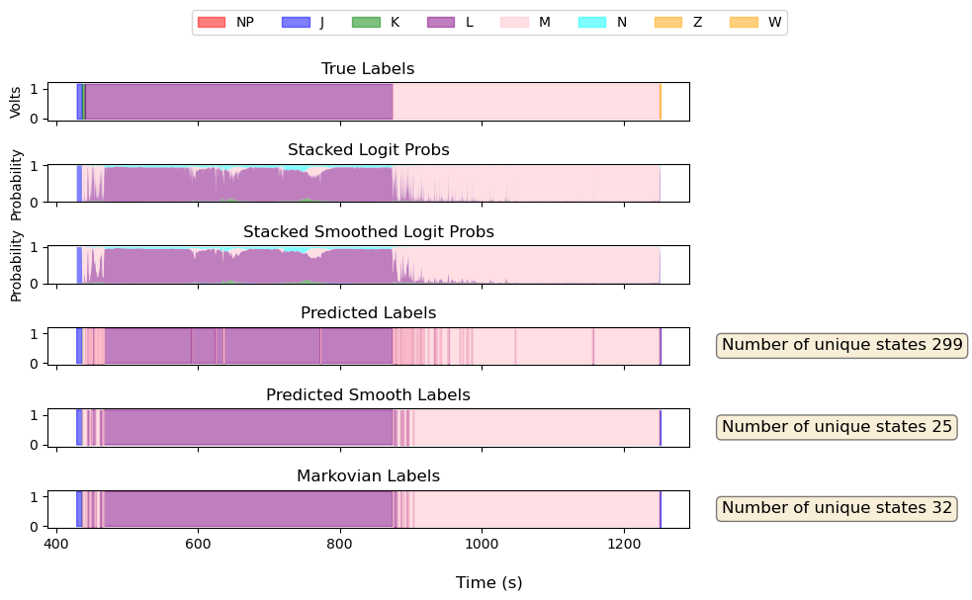
Post-processing
Hidden Markov Model (later, add semi)
Smoothing

Slide 14
Questions?

